Slide 1
Diffusion Monte Carlo (DMC)
Coire Gavin-Hanner, McCoy Group, UW

Slide 2
Outline
What is it and why do we care?
Terms
How does it work- Theory
How does it work- Practice
Advancements
Please interrupt with questions, comments, and suggestions!

Slide 3
What is DMC and why do we care?
- Potential energy surface
- Atoms
- Coordinates
DMC
- Wavefunction
- Zero point vib. energy
Good for systems that are not easily evaluated using other techniques
Large anharmonicity
Many degrees of freedom
Numerical rather than analytical approach

Slide 4
Terms
Potential energy surface
Walker
Eref- energy of the displaced system

Slide 5
How does it work
- Potential energy surface
- Atoms
- Coordinates
DMC
- Wavefunction
- Zero point vib. energy
Theory
How do we get to the wavefunction using the Schrödinger equation?
Practice
Basic
Important Sampling
NN-based PES evaluations
PyVibDMC!

Slide 6
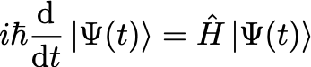
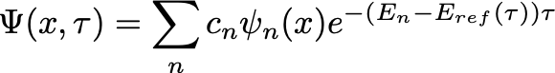
How does it work- Theory
Point(s) of Confusion
How does this get us the ground state wfn?
What if Eref = E1, E2…?

Slide 7
How does it work- Practice
Births and Deaths
Four-step algorithm
Displace the walkers
Calculate potential energy
Births and Deaths
Calculate Eref
Calculate Eref
Calculate Potential Energy
Start Here!
Calculate Potential Energy
Calculate Eref
Displace Walkers

Slide 8
How does it work- Practice cont.
Random displacement based on gaussian distribution of width (Δτ/m)^{1/2}
Result of the kinetic energy operator
Derivation left as an exercise to the viewer
Potential energy is calculated from new positions
Notes:
Temperature dependence?

Slide 9
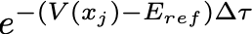
How does it work- Practice cont.
Previous E_{ref}
Births and Deaths

Slide 10
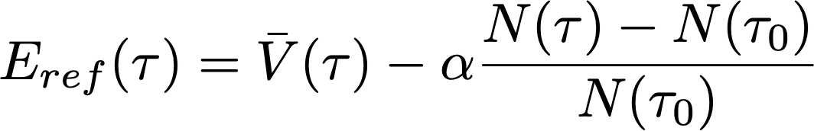
How it works- Practice cont
Calculating E_{ref} and ZPE
Average potential energy
# of walkers correction
Confusion:
- Kinetic Energy?

Slide 11
How it works- Practice cont.
Discrete weighting- fluctuating number of walkers with constant weight
Continuous weighting- constant number of walkers with fluctuating weight
Pros and Cons of both?

Slide 12
Advancements
Important sampling…
NN PES evaluations

Slide 13
Acknowledgements
McCoy Group
Xantheas Group

